Slide 1
TOPIC NAWAZ SHARIF 1ST TERM 1990-1993

Slide 2
NAWAZ SHARIF 1ST TERM 1990-1993
INTRODUCTION
THE NAWAZ SHARIF ERA 1990-1993
ACHIVEMENTS IN THIS ERA
WHY NAWAZ SHARIF DISMISED ?

Slide 3
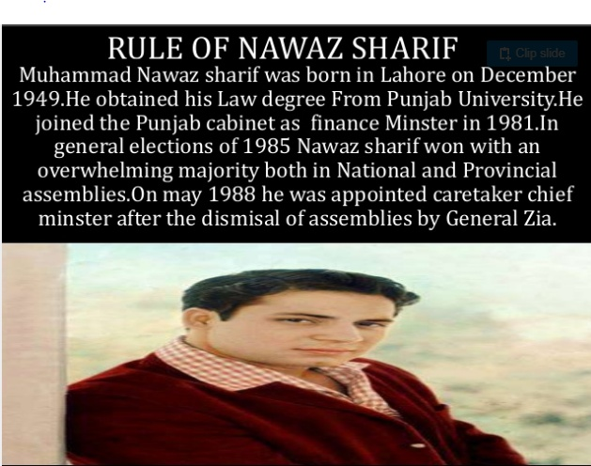
INTRODUCTION

Slide 4
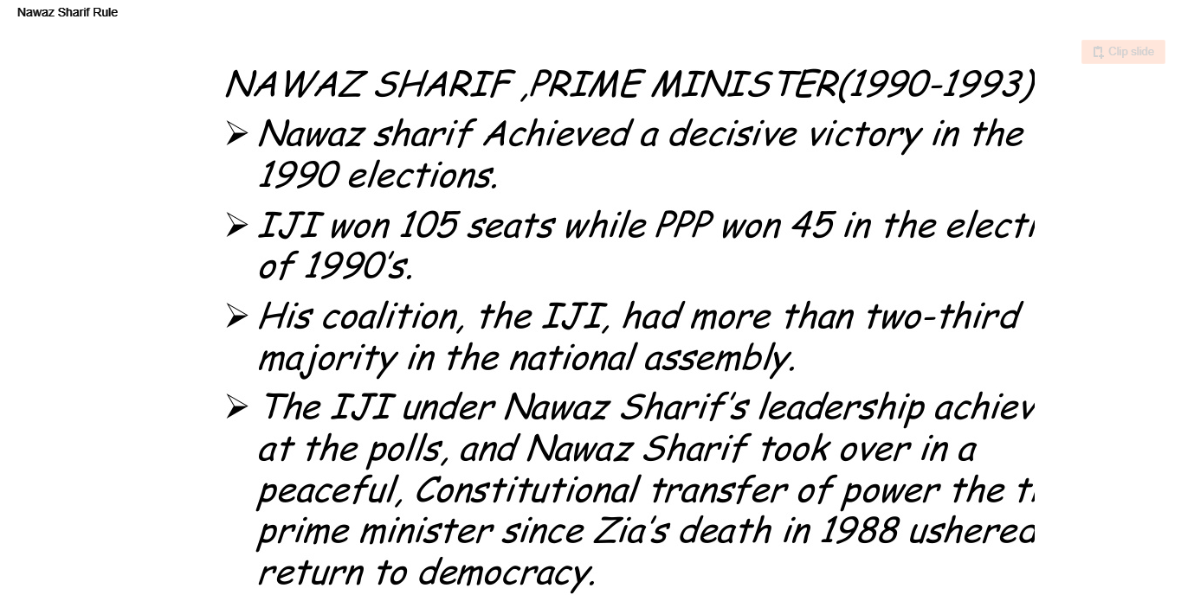
THE NAWAZ SHARIF ERA 1990-1993

Slide 5
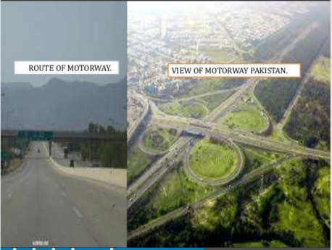

ACHIVEMENTS IN THIS ERA
The most important Achievement of NAWAZ Era
Was “MOTOR WAY” project.
• Foreign currency accounts were allowed
• He introduce large scale projects
1-Gawadar Main Port
2-Yellow Cab Scheme
• In his era he decided to observe the KASHMIR SOLIDARITY DAY on 5th febuary of every year
• He tried to stop smuggling and illegal weapon but “Kalashankov Culture” promoted during in his era

Slide 6
ACHIVEMENTS IN THIS ERA
Foreign investment increased
He took many steps to raise the KASHMIR
Issue on International forum.
• In his era He extended the membership of ECO(ECONOMIC COOPERATION ORAGNIZATION) to all Central Asian States.

Slide 7
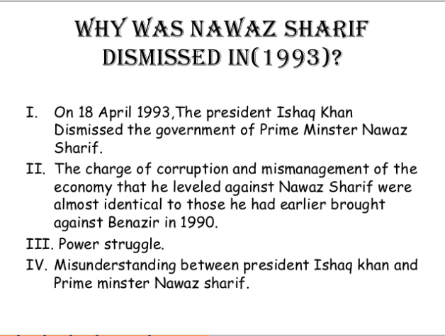
WHY NAWAZ SHARIF DISMISED ?

